Slide 1




HIT140
FOUNDATION OF DATA SCIENCE
Assessment 2 - Presentation
Lecturer: Dr Yakub Sebastian
Facilitator: Van Hieu Tran
Presented By: Group 31
Thi Xuan Thanh Tran (S389244)
Nguyen Duy Quang Lai (S389980)
Huu Thanh Le (S378046)
Tarik Bulut (S382893)

Slide 2


RESEARCH QUESTION
Do bats perceive rats not just as competitors for food but also as potential predators?
HYPOTHESIS
H0 (Null): Bats perceive rats only as food competitors, not as predators.
H1 (Alternative): Bats perceive rats as potential predators, showing avoidance, vigilance, and reduced reward.

Slide 3

WORKFLOW
Phase 1: Data loading & Overview
Phase 2: Cleaning & habit classification
Phase 3: Merge & threat indicators
Phase 4: Hypothesis testing (H1-H8)
Phase 5: GLM analysis
Phase 6: Conclusion

Slide 4
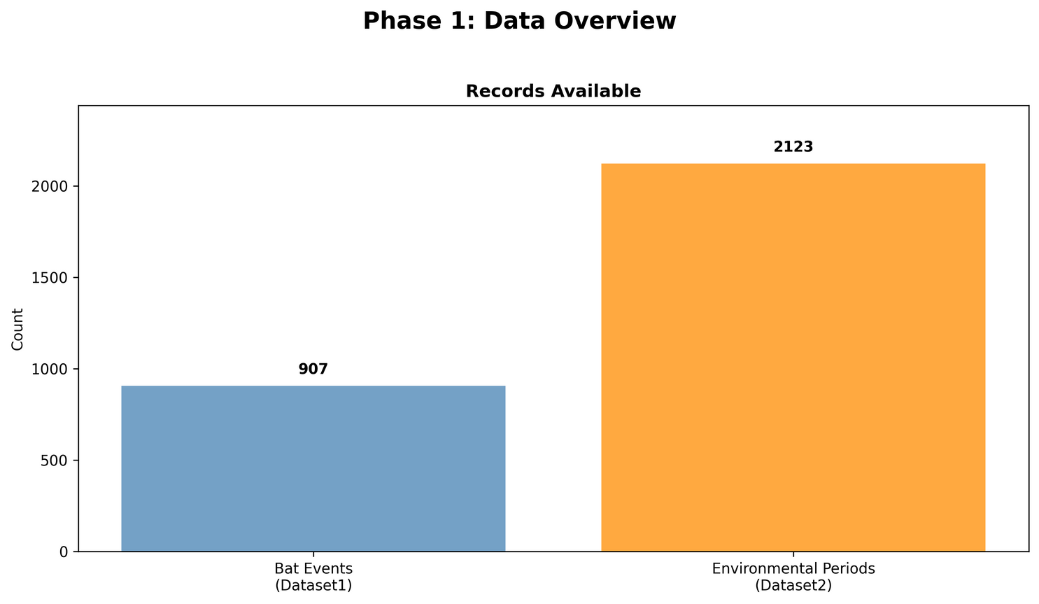
PHASE 1: DALA LOADING & OVERVIEW
Dataset 1: Bat events (individual landings, behaviour).
Dataset 2: Rats’ arrival events at the food platform (30-minute rat activity).

Slide 5
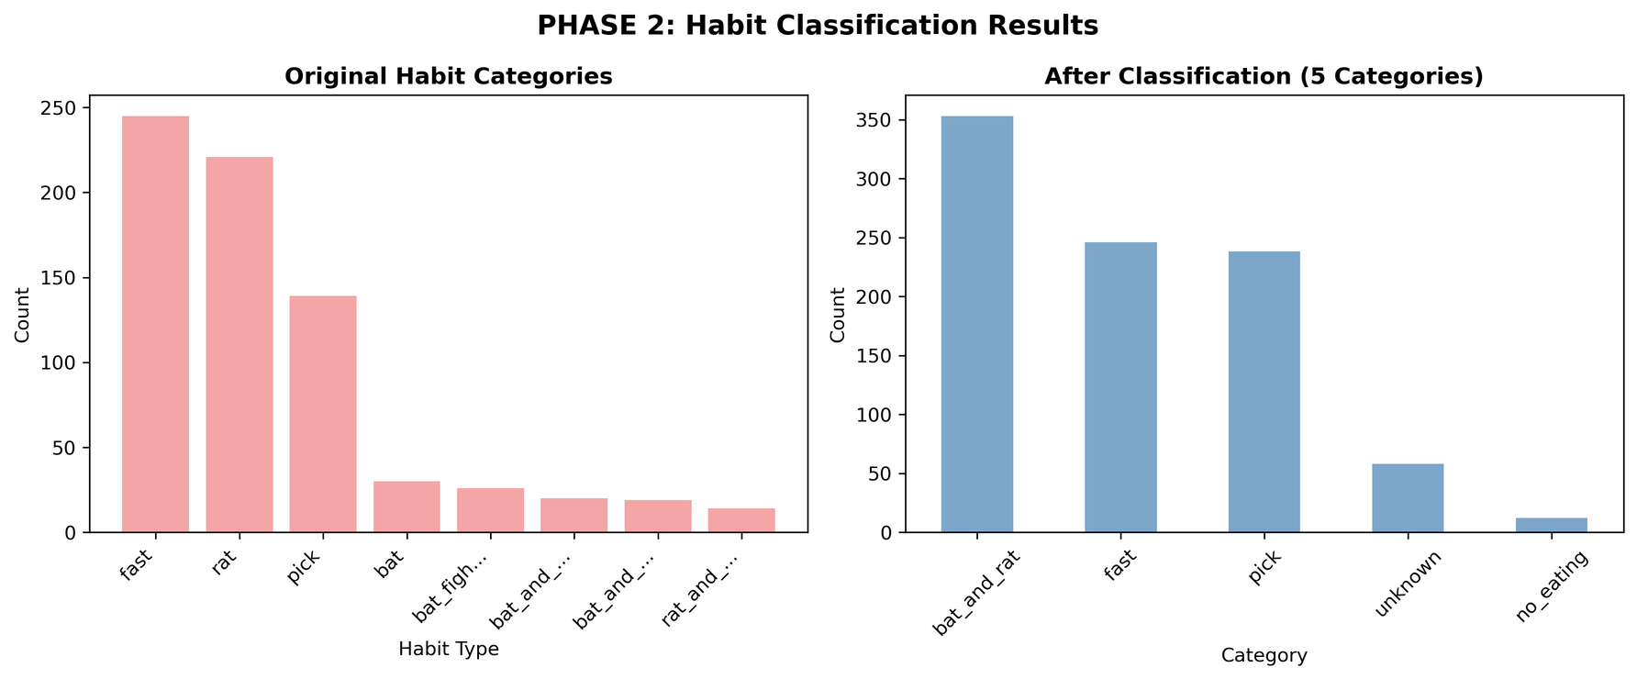
PHASE 2: CLEANING & HABIT CLASSIFICATION
Fix vigilance latency errors (<1s values)
Update habit categories

Slide 6
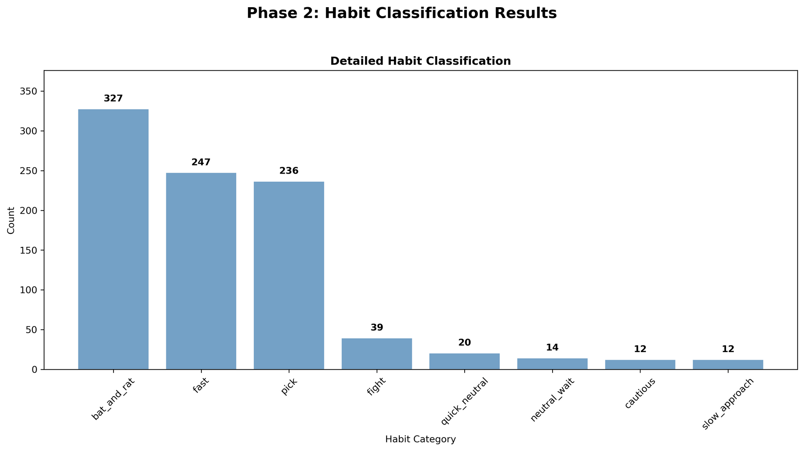
PHASE 2: CLEANING & HABIT CLASSIFICATION
Update habit categories

Slide 7
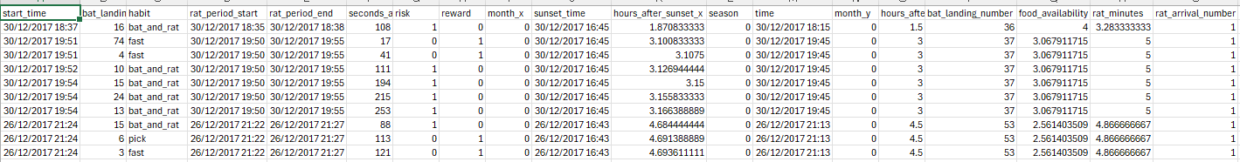
PHASE 3: MERGE & THREAT INDICATORS
Merge datasets
merge_asof(start_time ↔ time)
Each bat event linked to the nearest earlier 30-minute rat activity block
Creates a single table for analysis

Slide 8
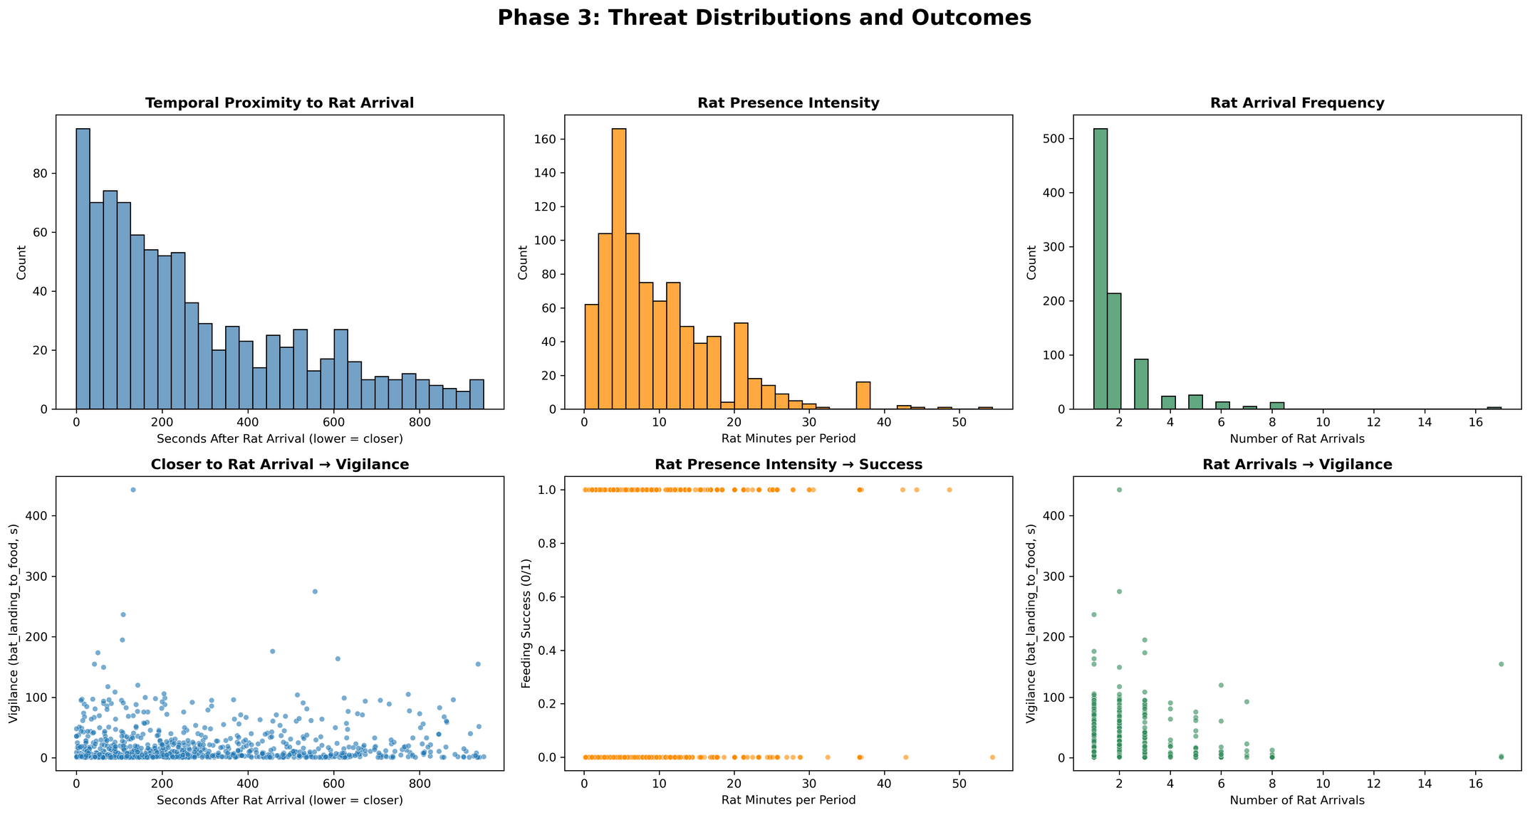
PHASE 3: MERGE & THREAT INDICATORS
Threat indicators
Proximity: seconds after rat arrival (lower = closer)
Intensity: rat_minutes (how long rats were present)
Frequency: rat_arrival_number (how many rat visits)

Slide 9
PHASE 3: MERGE & THREAT INDICATORS
Rat threat gradients statistics
RAT THREAT GRADIENT STATISTICS:
SECONDS AFTER RAT ARRIVAL - MEAN: 282.9 S, MEDIAN: 206.0 S
RAT MINUTES (FROM DATASET2) - MEAN: 10.2 MINS, MEDIAN: 7.8 MINS
RAT ARRIVAL NUMBER - MEAN: 1.9, MAX: 17

Slide 10
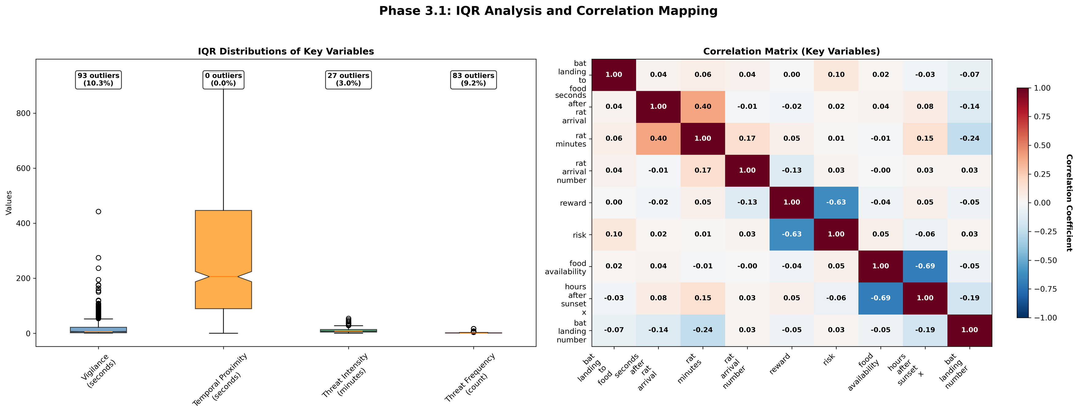
PHASE 3: MERGE & THREAT INDICATORS
IQR

Slide 11
PHASE 3: MERGE & THREAT INDICATORS
Correlation matrix

Slide 12
PHASE 4: HYPOTHESIS TESTING
Eight hypothesis:
H1 Proximity → Vigilance: closer to rat arrival ⇒ vigilance ↑ (latency ↑)
H2 Intensity → Success: more rat minutes ⇒ success ↓
H3 Frequency → Vigilance: more arrivals ⇒ vigilance ↑
H4 Frequency → Success: more arrivals ⇒ success ↓
H5-H6 Threat → Defensive behaviours: high-threat blocks show more ‘cautious/slow/fight’
H7 Time-of-night check (context, not a predator test)
H8 Composite threat index → Vigilance

Slide 13
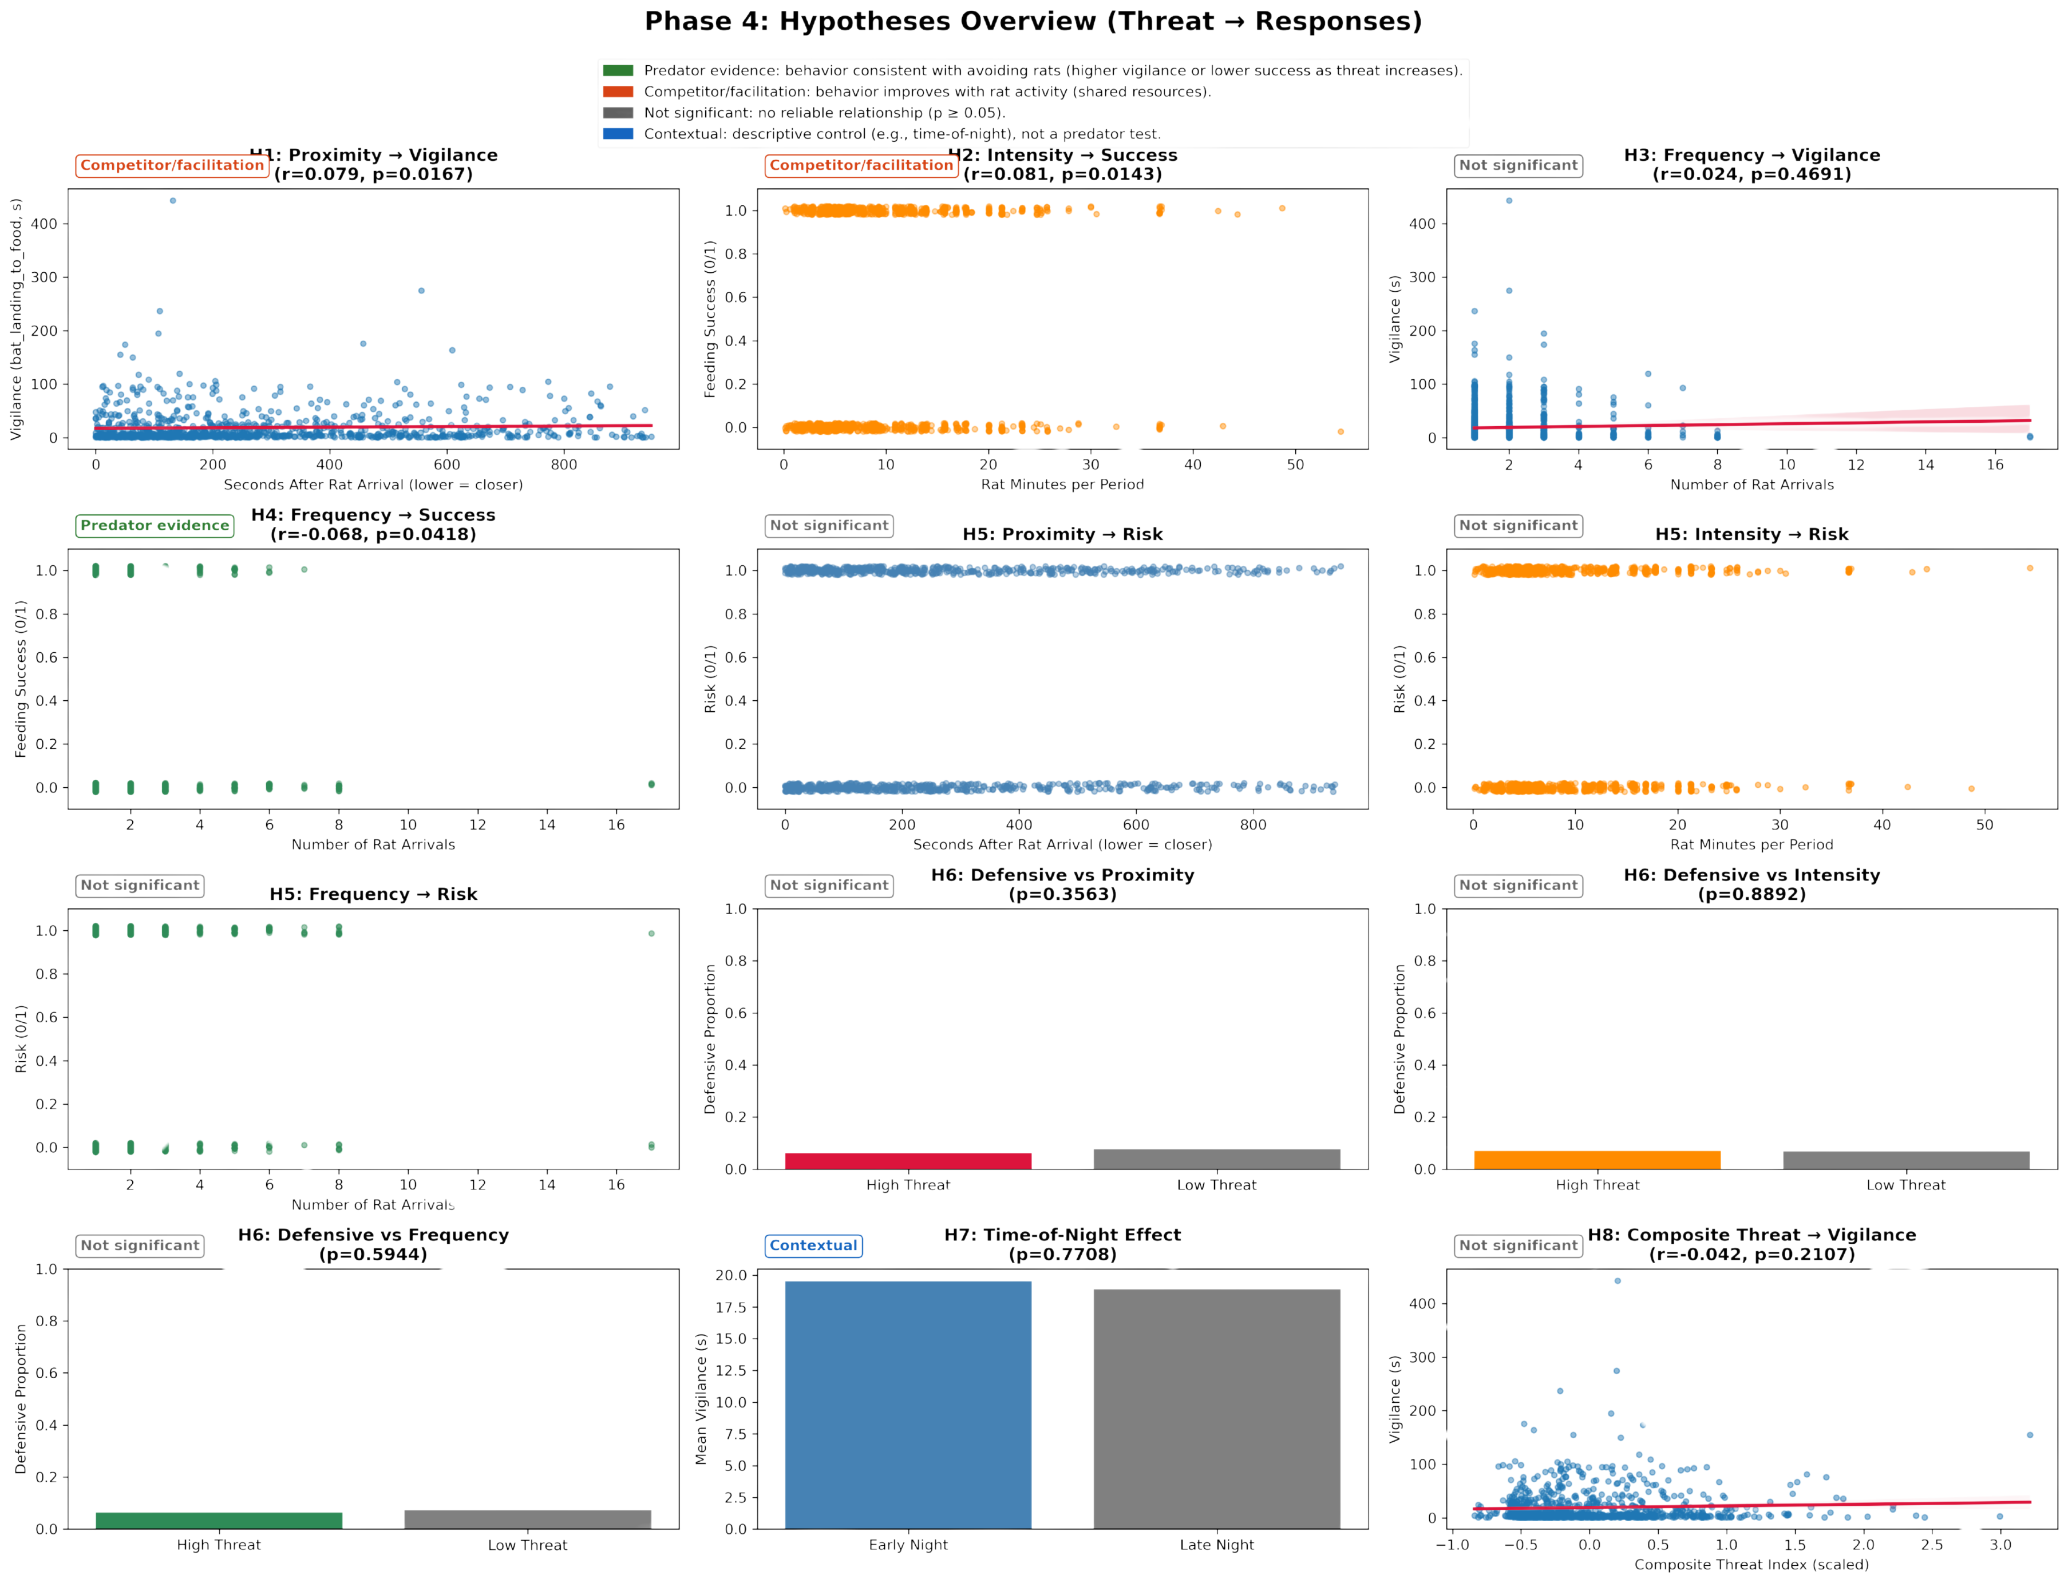
PHASE 4: HYPOTHESIS TESTING
H1: Do bats become more vigilant when rats arrive recently?
H1 Proximity → Vigilance:
EXPECTED: NEGATIVE CORRELATION (RECENT ARRIVAL → HIGHER VIGILANCE)
CORRELATION: R=0.0795
P-VALUE: 0.0167
RESULT: SIGNIFICANT
DIRECTION: OPPOSITE OF EXPECTED (CONTRADICTS)

Slide 14
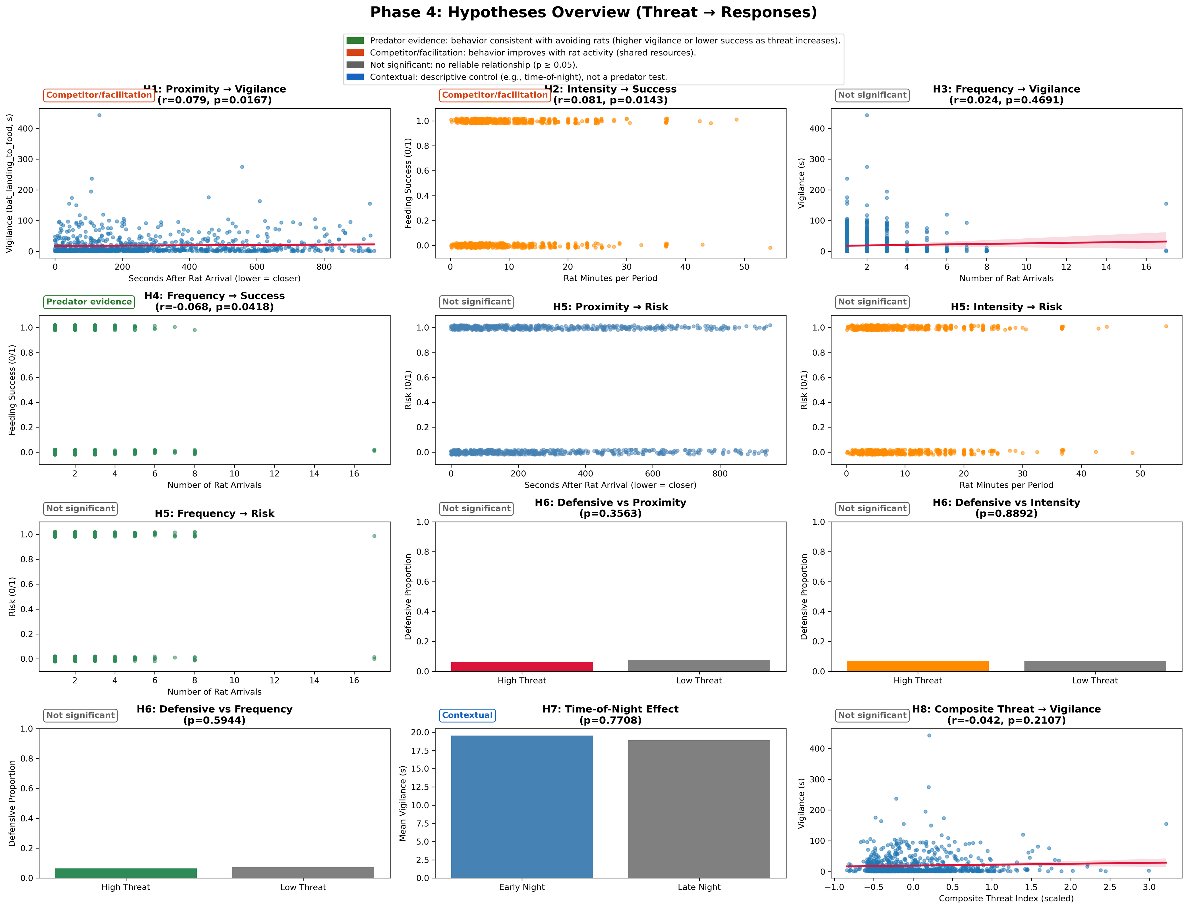
PHASE 4: HYPOTHESIS TESTING
H2: Does stronger rat presence reduce feeding success?
EXPECTED: NEGATIVE CORRELATION (MORE RAT MINUTES → LOWER SUCCESS)
CORRELATION: R=0.0813
P-VALUE: 0.0143
RESULT: SIGNIFICANT
DIRECTION: OPPOSITE OF EXPECTED (CONTRADICTS)

Slide 15
PHASE 4: HYPOTHESIS TESTING
H3: Do more rat arrivals make bats more vigilant?
EXPECTED: POSITIVE CORRELATION (MORE ARRIVALS → HIGHER VIGILANCE)
CORRELATION: R=0.0241
P-VALUE: 0.4691
RESULT: NOT SIGNIFICANT

Slide 16
PHASE 4: HYPOTHESIS TESTING
H4: Do more rat arrivals reduce feeding success?
EXPECTED: NEGATIVE CORRELATION (MORE ARRIVALS → LOWER SUCCESS)
CORRELATION: R=-0.0676
P-VALUE: 0.0418
RESULT: SIGNIFICANT
DIRECTION: AS EXPECTED (SUPPORTS)

Slide 17


PHASE 4: HYPOTHESIS TESTING
H5 ⟶ H8
H5: RISK-TAKING DECREASES WITH HIGHER THREAT
SECONDS_AFTER_RAT_ARRIVAL: R=0.0263, P=0.4281
RAT_MINUTES: R=-0.0225, P=0.4982
RAT_ARRIVAL_NUMBER: R=0.0292, P=0.3805
H6: DEFENSIVE BEHAVIORS INCREASE WITH THREAT
SECONDS_AFTER_RAT_ARRIVAL: HIGH=6.2%, LOW=7.7%, P=0.3563
RAT_MINUTES: HIGH=7.1%, LOW=6.8%, P=0.8892
RAT_ARRIVAL_NUMBER: HIGH=6.4%, LOW=7.3%, P=0.5944
H7: ANTI-PREDATOR BEHAVIOR CHANGES WITH TIME
EARLY NIGHT: 19.52S, LATE NIGHT: 18.90S
P-VALUE: 0.7708
H8: COMPOSITE THREAT INDEX PREDICTS VIGILANCE
CORRELATION WITH VIGILANCE: R=-0.0416
P-VALUE: 0.2107

Slide 18
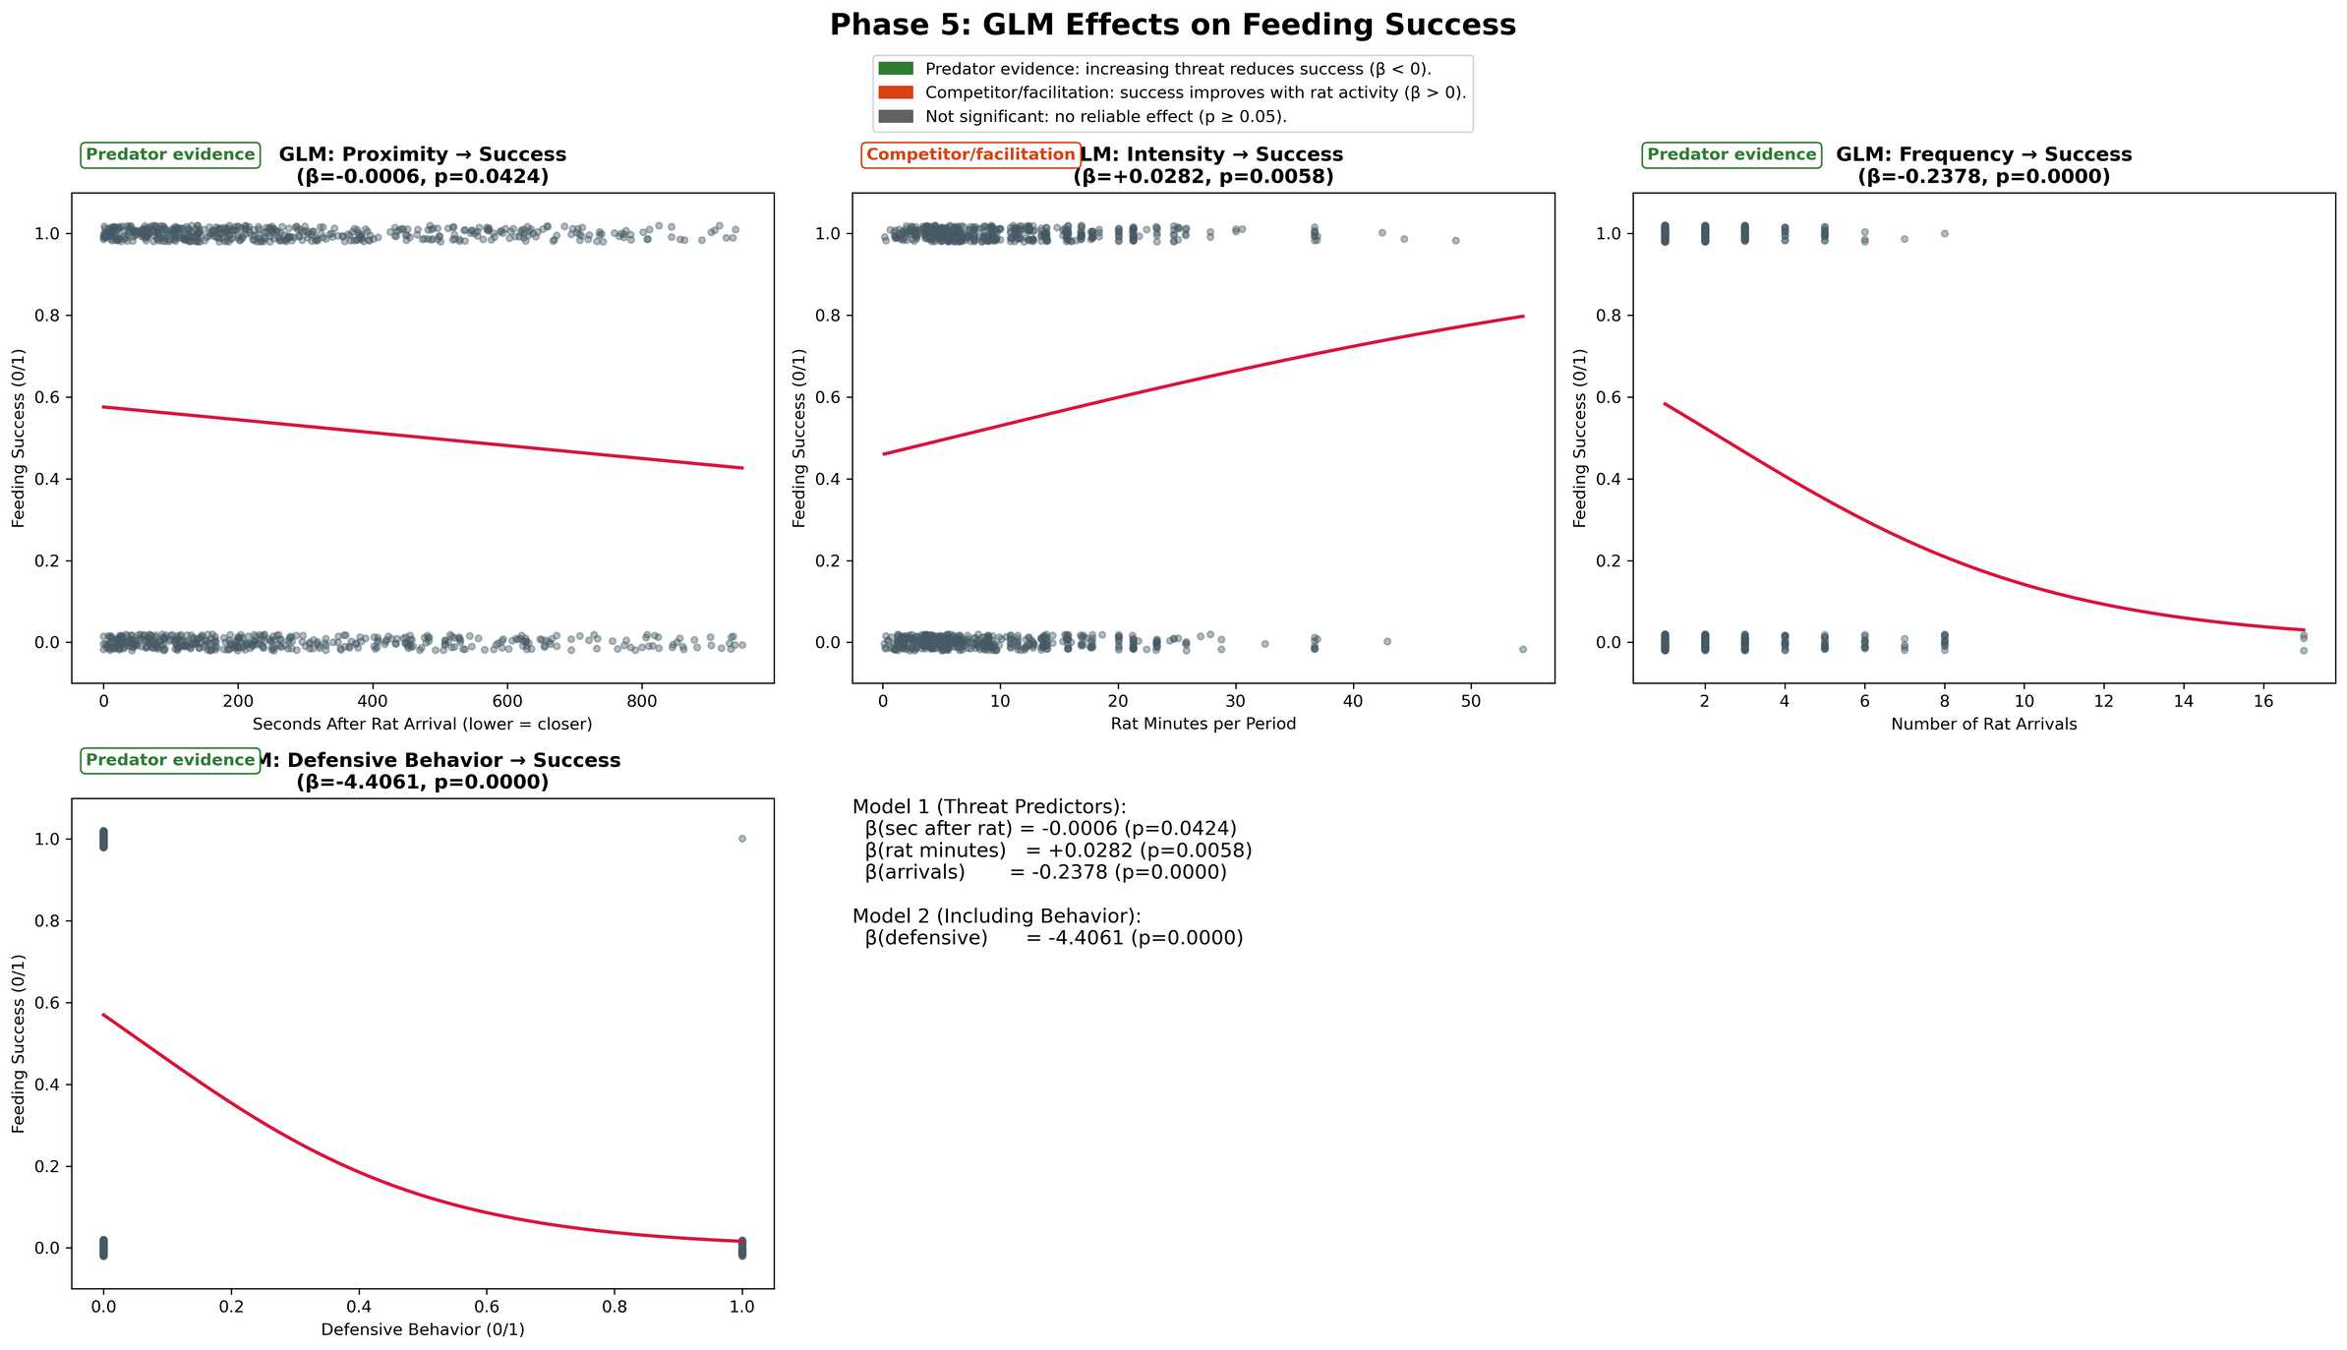
PHASE 5: GLM ANALYSIS

Slide 19
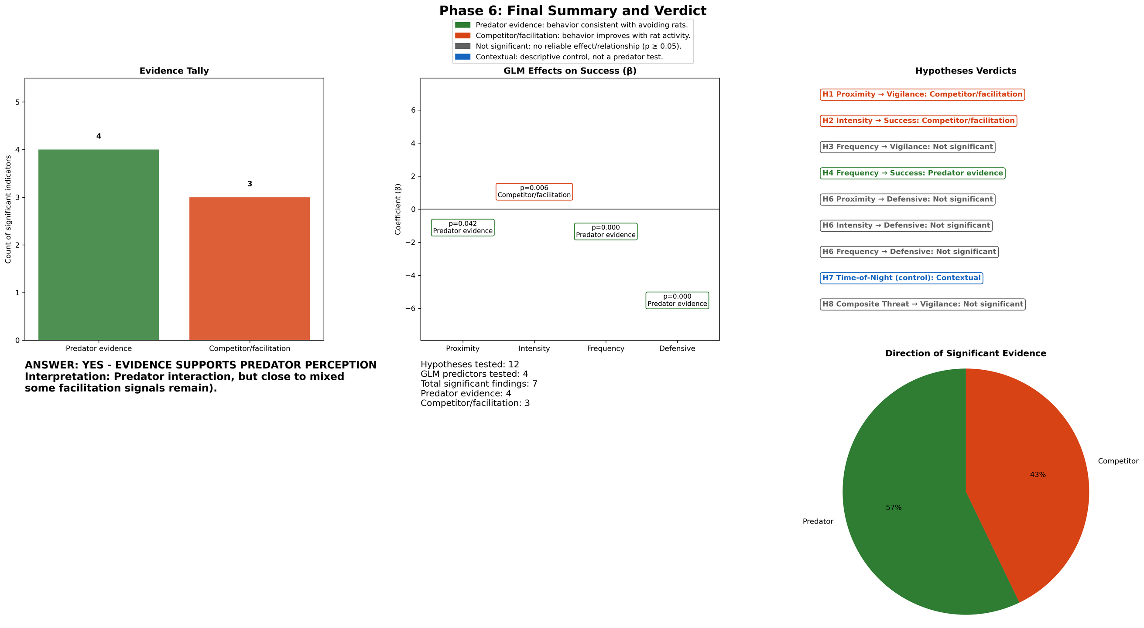
PHASE 6: CONCLUSION

